Slide 1
Information System
ITEC-522
First Semester Third Year
Information Technology
Dr. Khalil-ur-Rahmen Khoumbati
Professor
Department of Information Technology
Faculty of Engineering and Technology
University of Sindh, Jamshoro
Khalil.khoumbati@gmail.com
Week #10

Slide 2
SECURING INFORMATION SYSTEMS

Slide 3
System Vulnerability and Abuse
Security:
  Policies, procedures and technical measures used to prevent unauthorized access, alteration, theft, or physical damage to information systems
Controls:
  Methods, policies, and organizational procedures that ensure safety of organization’s assets; accuracy and reliability of its accounting records; and operational adherence to management standards
© Prentice Hall 2011

Slide 4
.
Why systems are vulnerable
  Accessibility of networks
  Hardware problems (breakdowns, configuration errors, damage from improper use or crime)
  Software problems (programming errors, installation errors, unauthorized changes)
  Disasters
  Use of networks/computers outside of firm’s control
  Loss and theft of portable devices
© Prentice Hall 2011

Slide 5
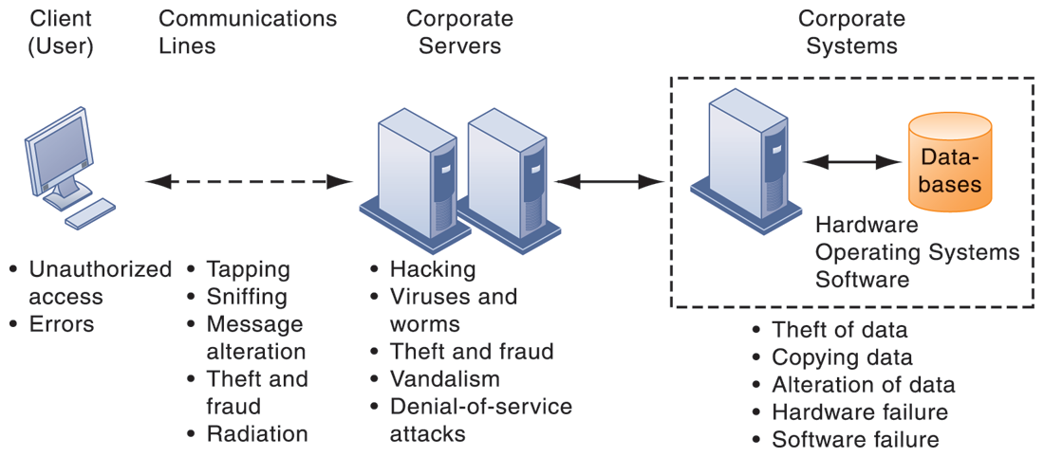
System Vulnerability and Abuse
CONTEMPORARY SECURITY CHALLENGES AND VULNERABILITIES
The architecture of a Web-based application typically includes a Web client, a server, and corporate information systems linked to databases. Each of these components presents security challenges and vulnerabilities. Floods, fires, power failures, and other electrical problems can cause disruptions at any point in the network.
© Prentice Hall 2011

Slide 6
Internet vulnerabilities
  Network open to anyone
  Size of Internet means abuses can have wide impact
  Use of fixed Internet addresses with cable or DSL modems creates fixed targets hackers
  Unencrypted VOIP
  E-mail, P2P, IM
    Interception
    Attachments with malicious software
    Transmitting trade secrets
© Prentice Hall 2011

Slide 7
Wireless security challenges
  Radio frequency bands easy to scan
  SSIDs (service set identifiers)
    Identify access points
    Broadcast multiple times
    War driving
      Eavesdroppers drive by buildings and try to detect SSID and gain access to network and resources
  WEP (Wired Equivalent Privacy)
    Security standard for 802.11; use is optional
    Uses shared password for both users and access point
    Users often fail to implement WEP or stronger systems
© Prentice Hall 2011

Slide 8
Malware (malicious software)
  Viruses
    Rogue software program that attaches itself to other software programs or data files in order to be executed
  Worms
    Independent computer programs that copy themselves from one computer to other computers over a network.
  Trojan horses
    Software program that appears to be benign but then does something other than expected.
© Prentice Hall 2011

Slide 9
Malware (cont.)
  SQL injection attacks
    Hackers submit data to Web forms that exploits site’s unprotected software and sends rogue SQL query to database
  Spyware
    Small programs install themselves surreptitiously on computers to monitor user Web surfing activity and serve up advertising
  Key loggers
    Record every keystroke on computer to steal serial numbers, passwords, launch Internet attacks
© Prentice Hall 2011

Slide 10
Hackers and computer crime
    System intrusion
    System damage
    Cybervandalism
      Intentional disruption, defacement, destruction of Web site or corporate information system
© Prentice Hall 2011

Slide 11
Spoofing
  Misrepresenting oneself by using fake e-mail addresses or masquerading as someone else
  Redirecting Web link to address different from intended one, with site masquerading as intended destination
Sniffer
  Eavesdropping program that monitors information traveling over network
  Enables hackers to steal proprietary information such as e-mail, company files, etc.
© Prentice Hall 2011

Slide 12
Denial-of-service attacks (DoS)
  Flooding server with thousands of false requests to crash the network.
Distributed deniaf-service attacks (DDoS)
  Use of numerous computers to launch a DoS
  Botnets
    Networks of “zombie” PCs infiltrated by bot malware
    Worldwide, 6 - 24 million computers serve as zombie PCs in thousands of botnets
© Prentice Hall 2011

Slide 13
Computer crime
  Defined as “any violations of criminal law that involve a knowledge of computer technology for their perpetration, investigation, or prosecution”
  Computer may be target of crime, e.g.:
    Breaching confidentiality of protected computerized data
    Accessing a computer system without authority
  Computer may be instrument of crime, e.g.:
    Theft of trade secrets
    Using e-mail for threats or harassment
© Prentice Hall 2011

Slide 14
Identity theft
  Theft of personal Information (social security id, driver’s license or credit card numbers) to impersonate someone else
Phishing
  Setting up fake Web sites or sending e-mail messages that look like legitimate businesses to ask users for confidential personal data.
Evil twins
  Wireless networks that pretend to offer trustworthy Wi-Fi connections to the Internet
© Prentice Hall 2011

Slide 15
Pharming
  Redirects users to a bogus Web page, even when individual types correct Web page address into his or her browser
Click fraud
  Occurs when individual or computer program fraudulently clicks on online ad without any intention of learning more about the advertiser or making a purchase
Cyberterrorism and Cyberwarfare
© Prentice Hall 2011

Slide 16
Internal threats: employees
  Security threats often originate inside an organization
  Inside knowledge
  Sloppy security procedures
    User lack of knowledge
  Social engineering:
    Tricking employees into revealing their passwords by pretending to be legitimate members of the company in need of information
© Prentice Hall 2011

Slide 17
Software vulnerability
  Commercial software contains flaws that create security vulnerabilities
    Hidden bugs (program code defects)
      Zero defects cannot be achieved because complete testing is not possible with large programs
    Flaws can open networks to intruders
  Patches
    Vendors release small pieces of software to repair flaws
    However exploits often created faster than patches be released and implemented
© Prentice Hall 2011

Slide 18
Discussion
Questions?

